Slide 1
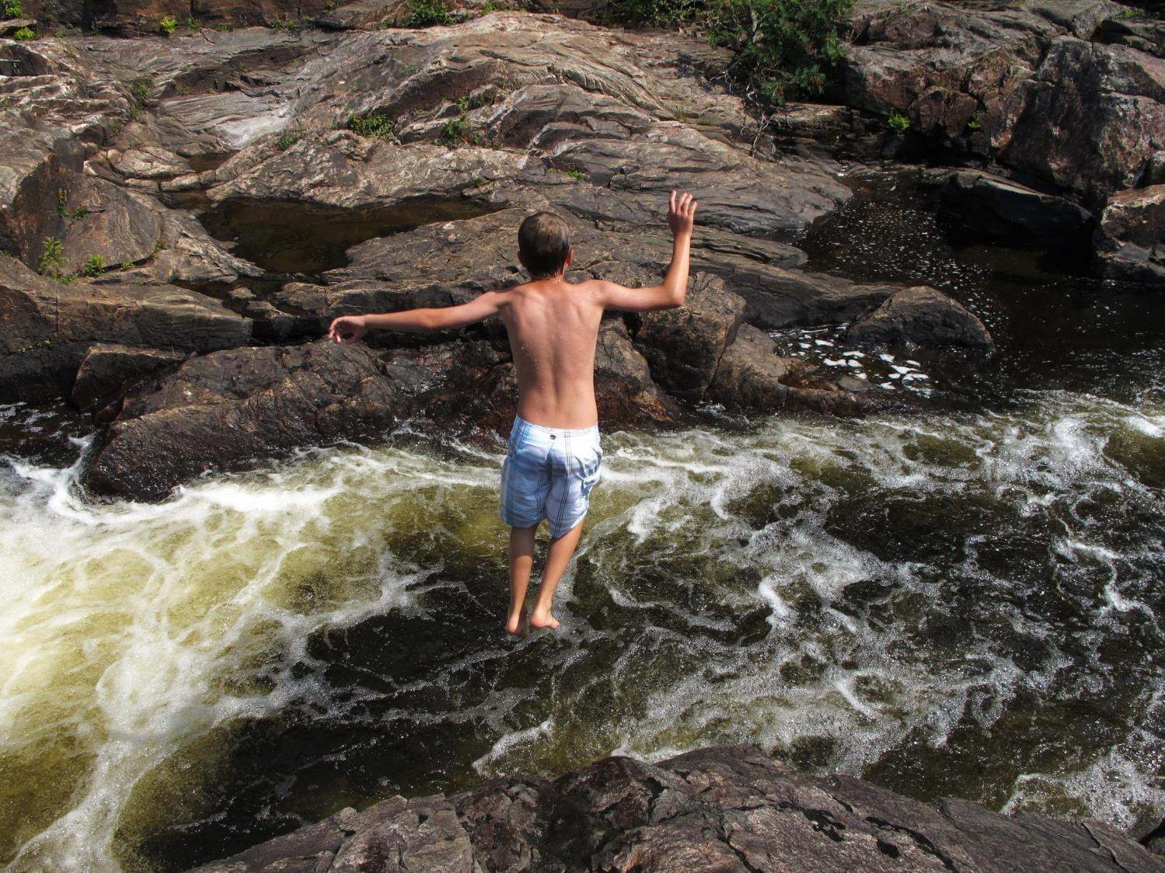
FAITH IS…

Slide 2
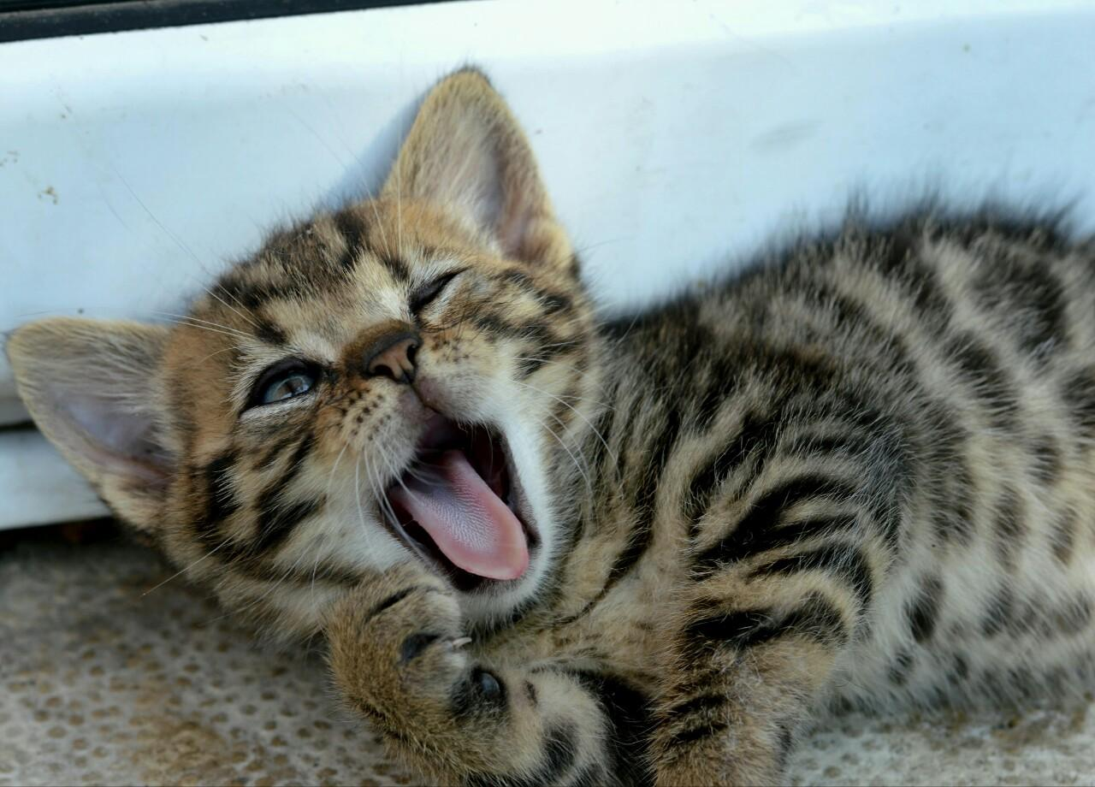
Faith is learning to rest in God’s strong care.

Slide 3
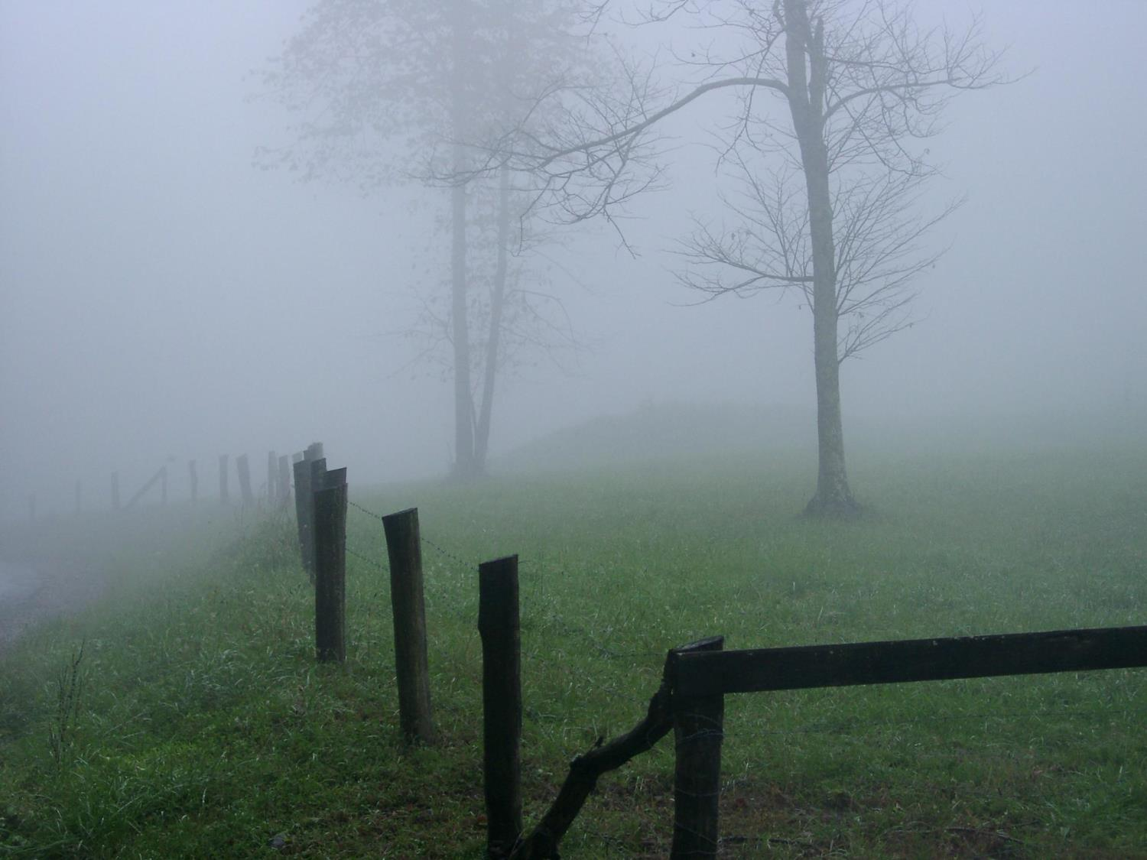
Faith is the radar
that sees through the fog.
- Corrie ten Boom

Slide 4
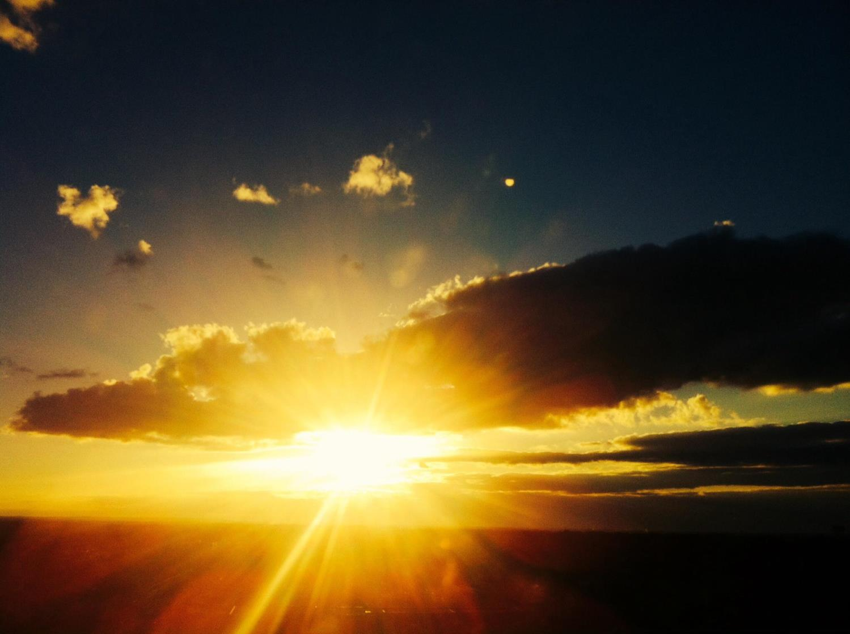
“The tragedy of life is not that it ends so soon
But that we wait so long to begin it.”
- W.M. Lewis

Slide 5
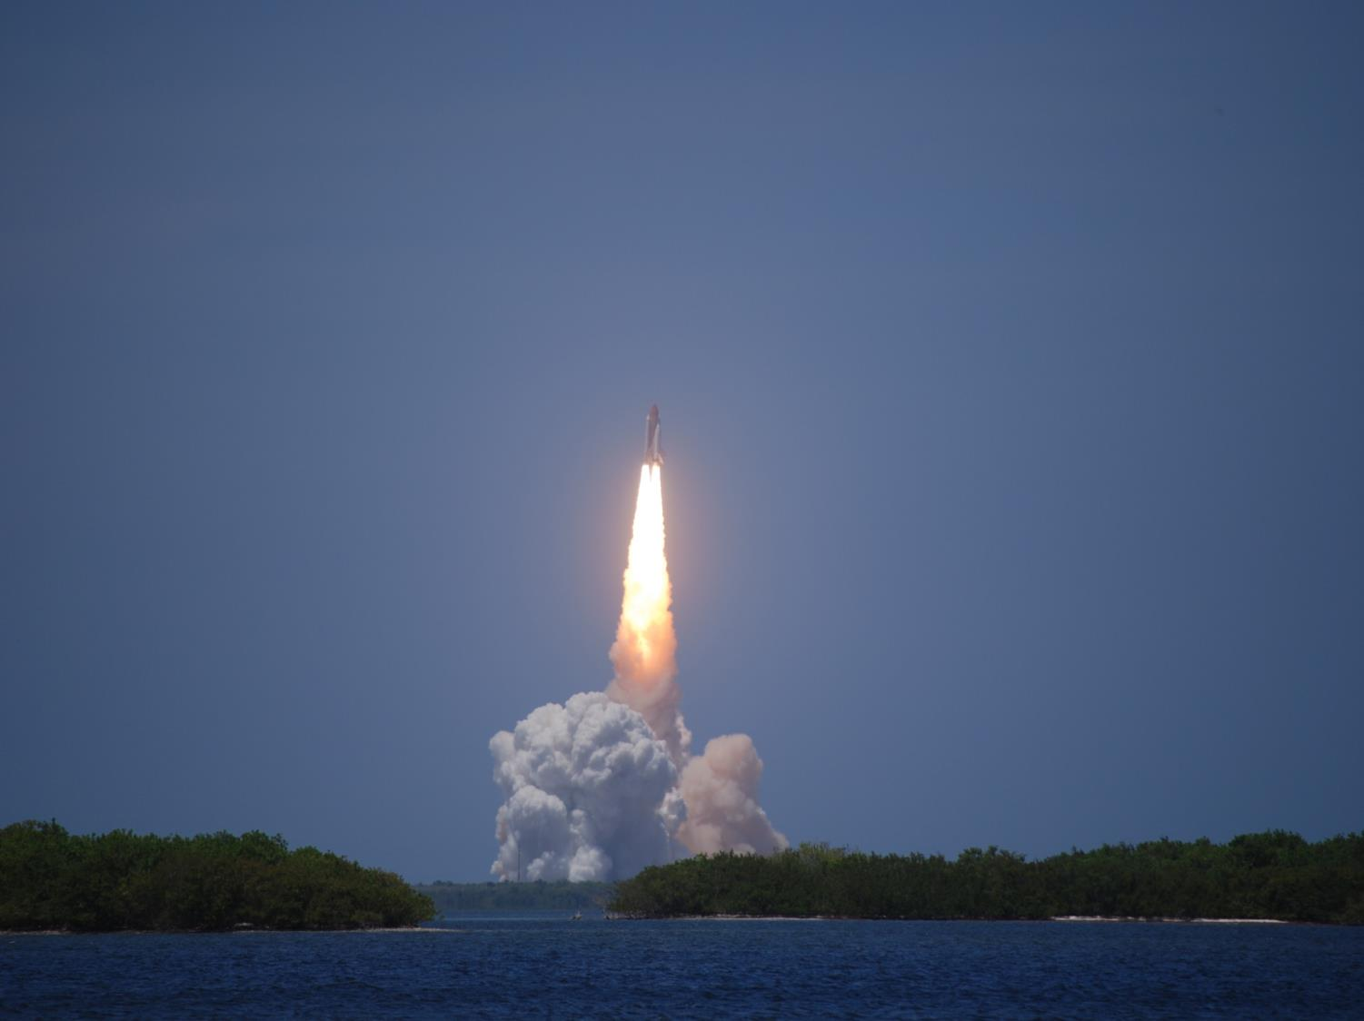
Faith is a recognition of those things
which are above the senses.
- Henry Ward Beecher

Slide 6
How do you remain
steadfast and immovable
during a trial of faith?
You immerse yourself
in the very things that helped build
your core of faith.
Neil Anderson

Slide 7
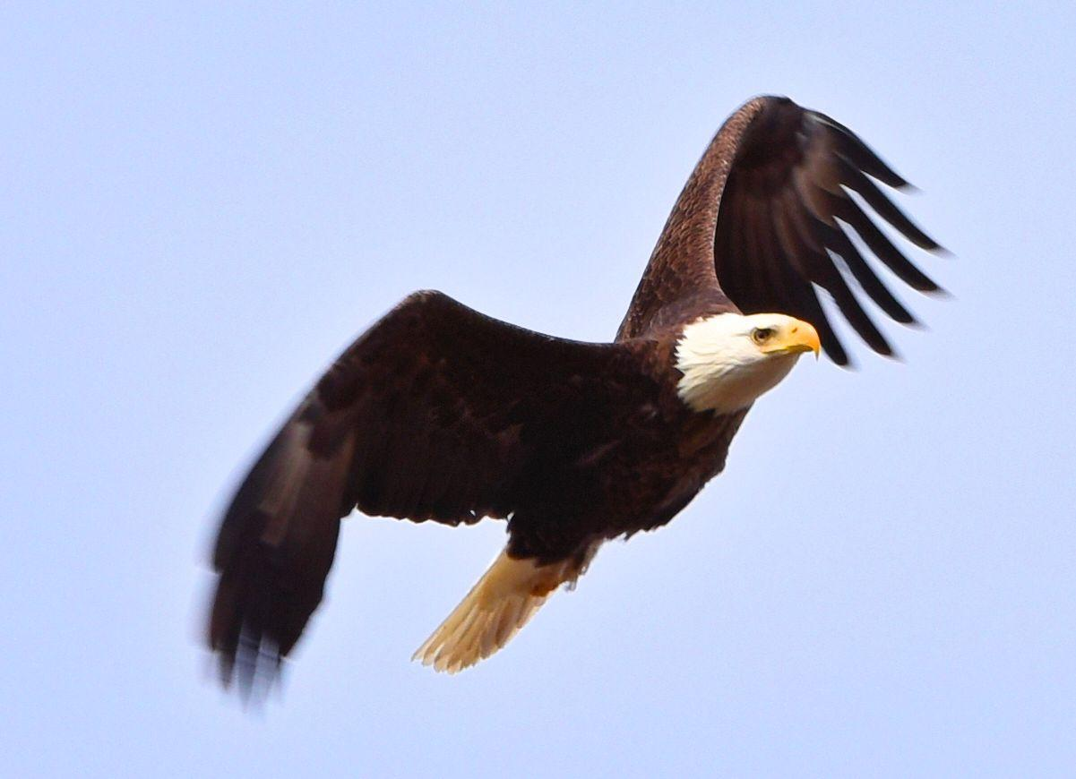
Which will you choose today?
FEAR
or
FAITH?

Slide 8
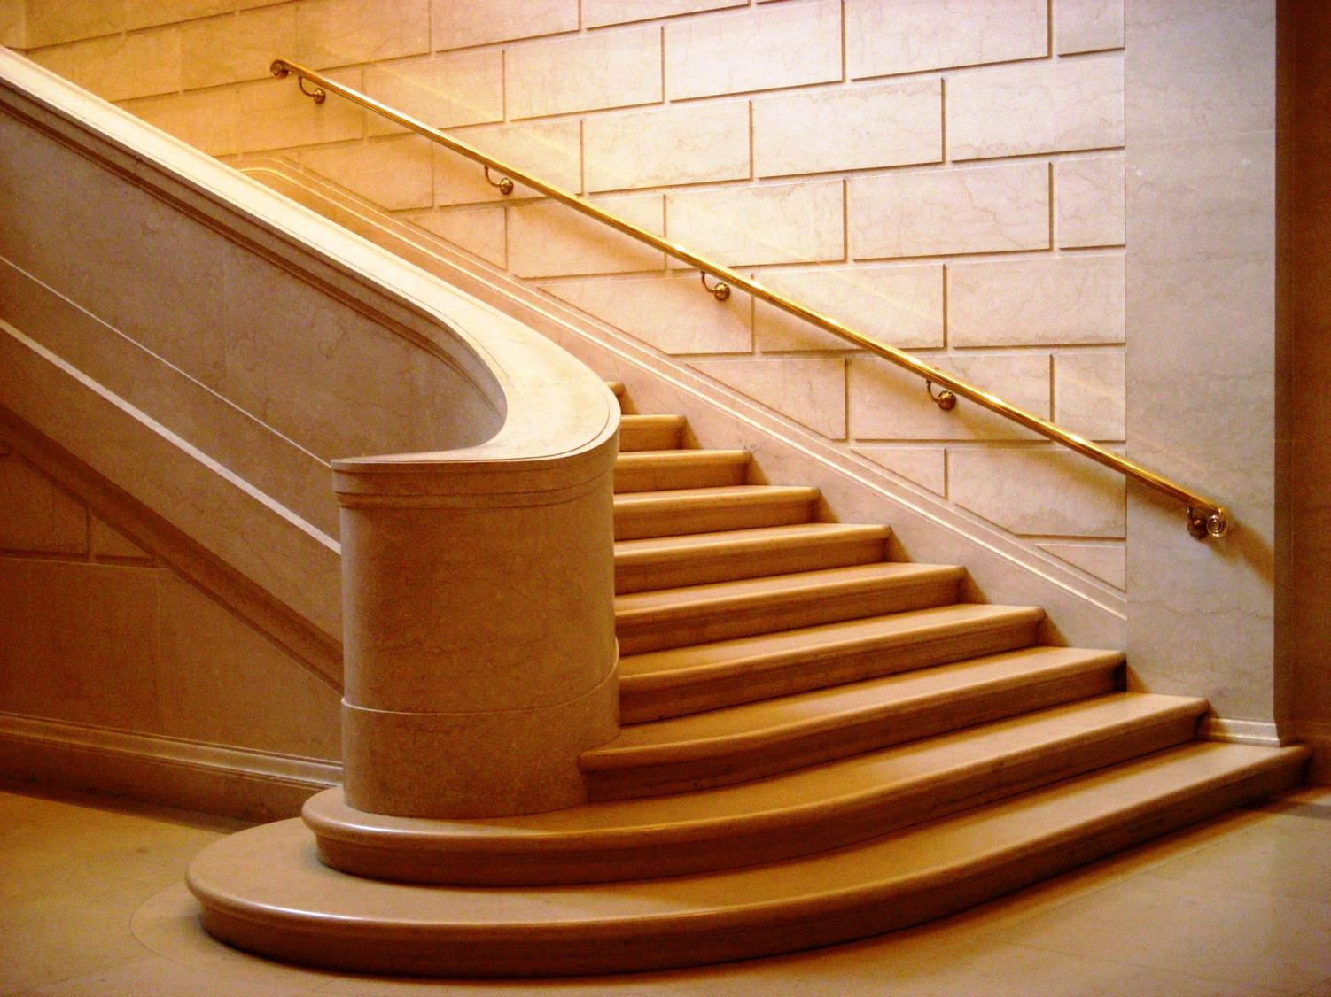
FAITH is taking the FIRST STEP
even when you don’t see the
whole
staircase.

Slide 9
FAITH IN ACTION
BE THE CHURCH!

Slide 10
FAITH is seeing light with your heart
when all your eyes see is darkness.

Slide 11
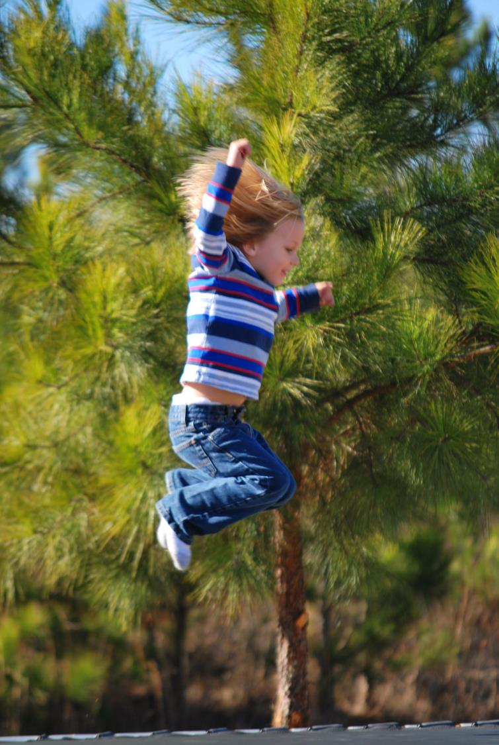
Sometimes
your only transportation
is a leap of faith.
- Margaret Shepherd

Slide 12
“FAITH
is deliberate confidence
in the character of GOD
whose ways you may not
understand at the time.”
- Oswald Chambers

Slide 13
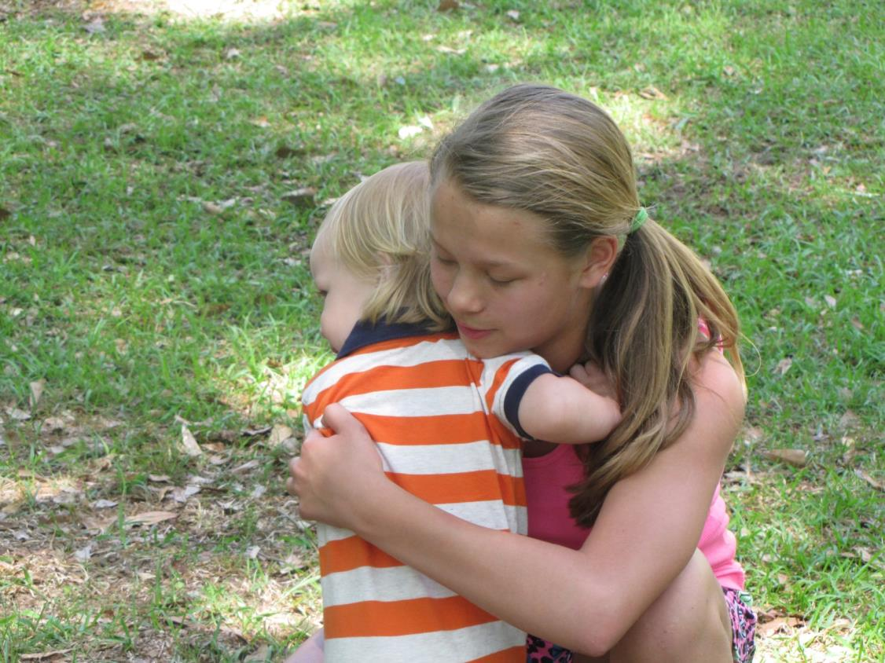
The greatest test of faith
is when you don’t
get what you want
but are still
able to say
THANK YOU LORD

Slide 14
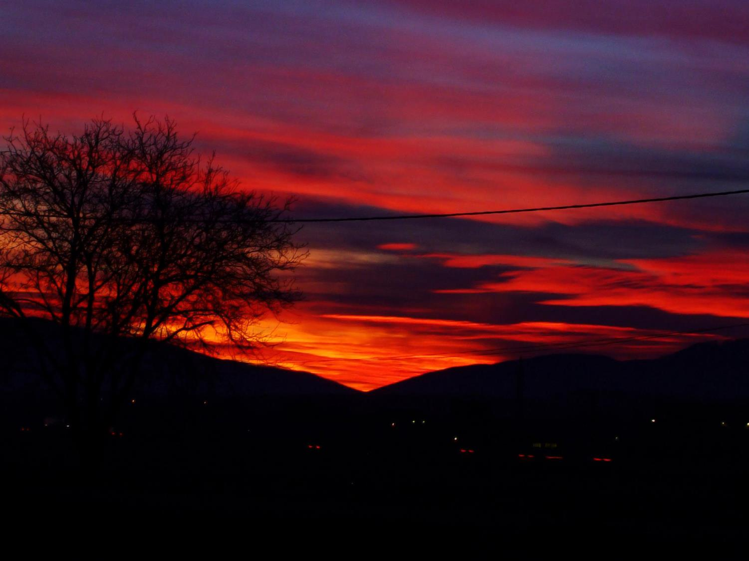
Don’t forget to pray today
because God did not forget
to wake you up this morning.

Slide 15
Spread faith

Slide 16
FAITH
is carried
by the unfettered
JOY
of the Creator.

Slide 17
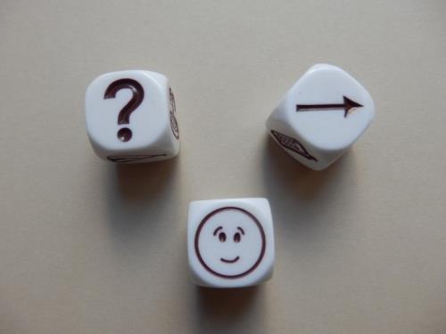
“I have learned that FAITH
means trusting in advance
what will only make sense
in reverse.”
- Phillip Yancey

Slide 18
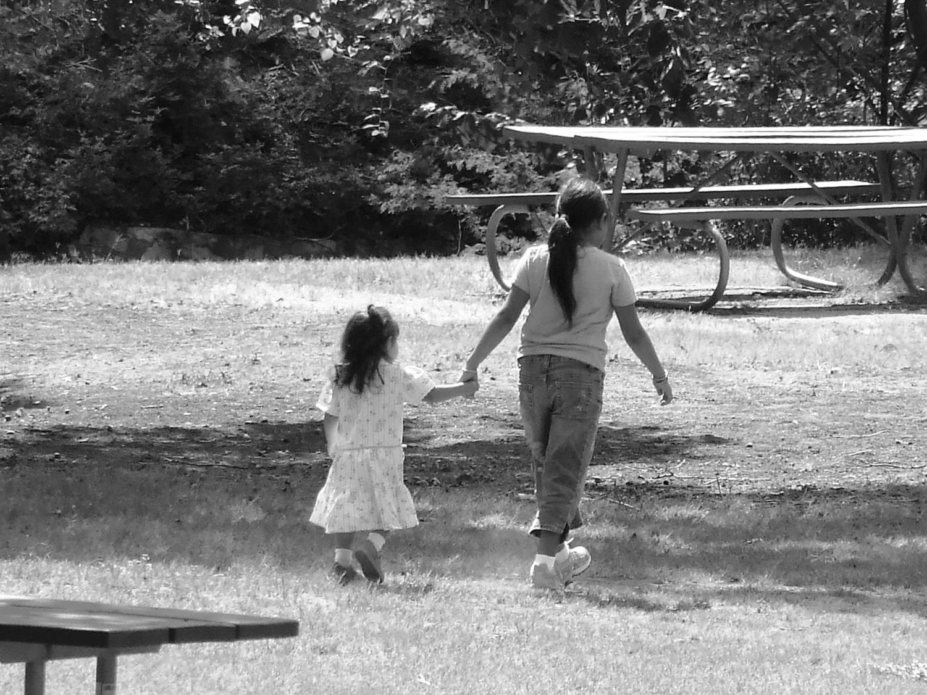
Faith may not see the future…
… but trusts the One who holds it.

Slide 19
Now FAITH is the assurance of things hoped for
and the conviction of things not seen
Hebrews 11:1

