Slide 1
Five Positive Things
You Can Do
when under Pressure

Slide 2
Based on 1 Peter 3, you can:
Learn to discover the VALUE of suffering (v. 1, 7)
Listen to your SOUL (v. 4, 16, 21-22)
Listen to the soul of ANOTHER (v. 7)
Practice BLESSING instead of blaming (v. 9, 14)
Answer people’s questions about the
HOPE they feel from you. (v. 15)

Slide 3
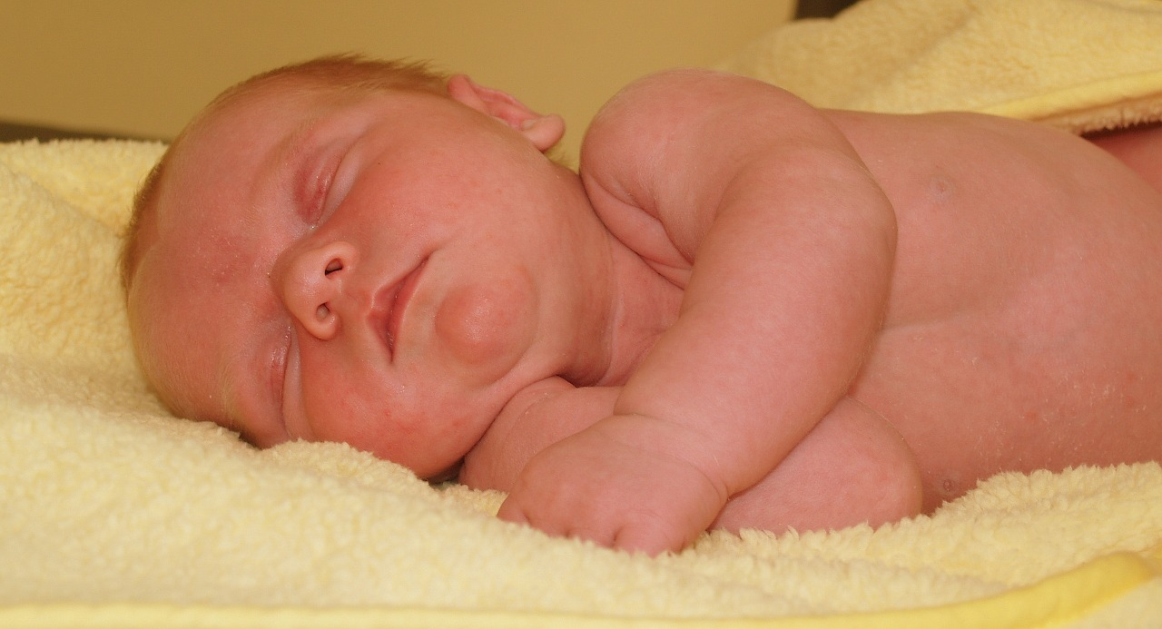
These things I have spoken to you that in Me
you might have peace. In the world you will have
tribulation, but be of good cheer for I have
overcome the world! - Jesus (John 16: 33)

