Slide 2
SCENE 1:
WE WANT TO LIVE LIFE ON OUR OWN SELF-CENTERED TERMS.
WE HAVE CUT OURSELVES OFF FROM GOD’S LOVE AND TRUTH
AND ULTIMATELY FROM LIFE ITSELF.
THE MORE WE TRY TO ESCAPE OUR ISOLATION, THE WORSE IT GETS.
We all, like sheep, have gone astray,
each of us has turned to our own way…
Isaiah 53: 6a

Slide 3
SCENE 2:
GOD SENT JESUS TO RESCUE US FROM OUR SELF-CENTERED LIFE.
JESUS TOOK ALL OF OUR SUFFERING, FEAR, AND DISCONNECTION AS
WE NAILED HIM TO A CROSS… BUT HE WAS RAISED TO LIFE!
WHEN WE TRUST JESUS WITH OUR WHOLE LIFE, HE GUIDES US INTO
ABUNDANT LIFE.
“I am the door; if anyone enters through Me, he will be saved, and will go in and out and find pasture. The thief comes only to steal and kill and destroy; I came that they may have life, and have it abundantly. I am the good shepherd; the good shepherd lays down His life for the sheep. John 10: 9-11

Slide 4
SCENE 3:
WE RECEIVE A NEW IDENTITY WHERE LOVE CONNECTS US TO
A NEW WAY OF SEEING AND EXPERIENCING LIFE.
OUR HEART EXPANDS, MORE AND MORE, TO TOUCH GOD AND
OTHERS DEEPLY.
NEW FOUND JOY AND PEACE AND POWER AND PURPOSE BEGIN
TO OVERFLOW INTO EVERY ASPECT OF OUR LIVING.
For the love of Christ controls us, having concluded this, that one died for all, therefore all died; and He died for all, so that they who live might no longer live for themselves, but for Him who died and rose again on their behalf. Therefore from now on we recognize no one according to the flesh; even though we have known Christ according to the flesh, yet now we know Him in this way no longer. Therefore if anyone is in Christ, he is a new creature; the old things passed away; behold, new things have come. 2 Corinthians 5: 14-17

Slide 5
SCENE 4:
AS OUR ADVENTURE WITH JESUS EXPANDS, GOD BRINGS US TO PEOPLE
WHO ARE STILL LOCKED INSIDE THEMSELVES.
THE LOVE OF CHRIST HELPS US TO SEE THEM IN NEW WAYS AND SERVE
THEM AS WE SEE THE FATHER SERVING THEM.
WE ARE AMBASADORS FOR CHRIST AND HIS KINGDOM, DEMONSTRATING
TRANSFORMED THINKING AND LIVING, AND INVITING THEM TO ABUNDANT
LIVING THROUGH FOLLOWING JESUS DAILY.
Now all these things are from God, who reconciled us to Himself through Christ and gave us the ministry of reconciliation, namely, that God was in Christ reconciling the world to Himself, not counting their trespasses against them, and He has committed to us the word of reconciliation. Therefore, we are ambassadors for Christ, as though God were making an appeal through us; we beg you on behalf of Christ, be reconciled to God. He made Him who knew no sin to be sin on our behalf, so that we might become the righteousness of God in Him. 2 Corinthians 5: 18-21

Slide 6
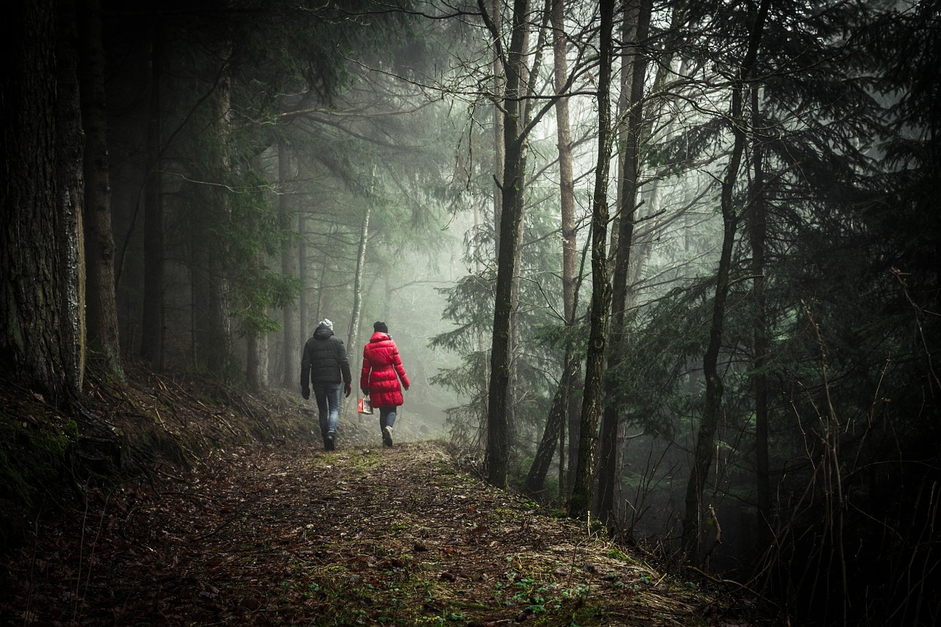
FOLLOWING JESUS’ EXAMPLE:
WE CONNECT WITH GOD,
WE CONNECT WITH OTHERS,
WE CONNECT OTHERS TO GOD.
Live the adventure!

